Slide 1



Theme B.2- Programming Constructs
B.2.3.1 - Code Instructions
Statement of Inquiry:The logical sequence of instructions within a system is essential for ensuring accurate and predictable outcomes
Key concepts: Systems
ATL Skill: Thinking , Research
Related concepts: logic
IB Learner Profile: Risk Takers
TOK Link :To what extent is "logical truth" dependent on the order of operations?

Slide 2




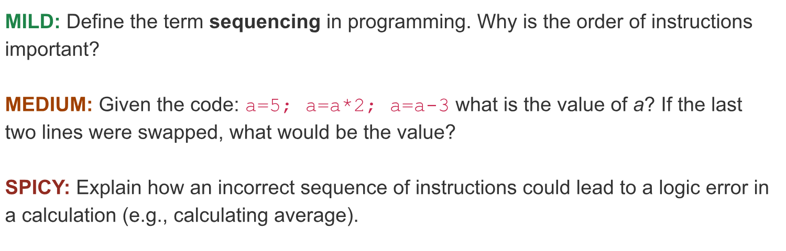


Do Now Activity
Pick one starter question according to your level, and discuss in your table .
Learning Intentions:
To understand the concept of sequencing and how the specific order of instructions affects the outcome of a program.
Success Criteria:
Students will be able to explain the importance of correct instruction order in programming.
Students will be able to identify and avoid common programming errors like infinite loops and deadlocks (where applicable).
Students will be able to analyze code segments to predict output and identify potential issues.

Slide 3
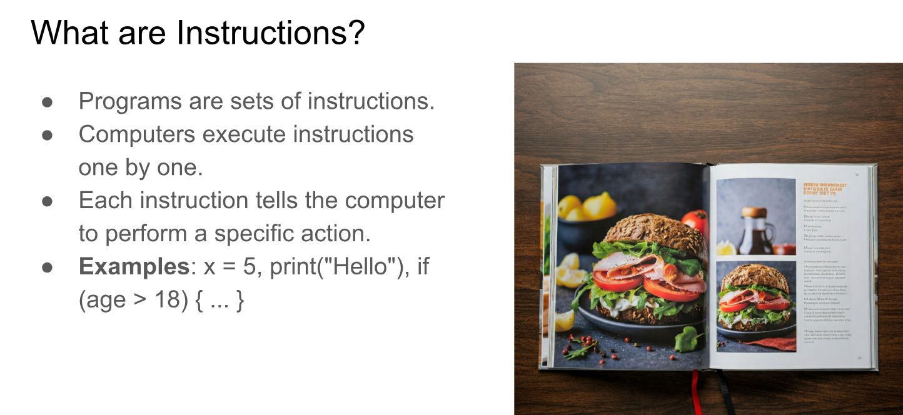

Slide 4
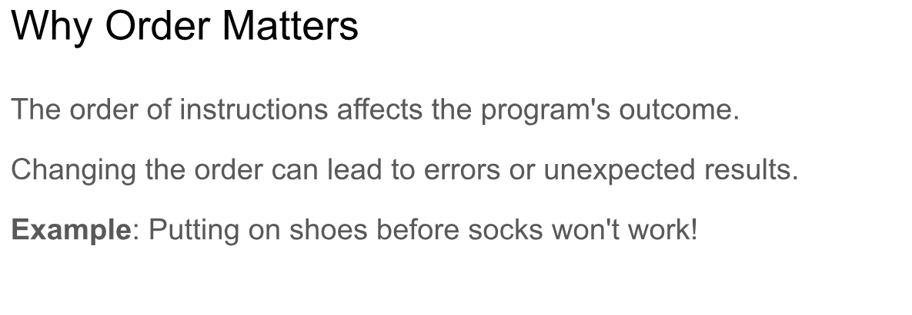

Slide 5


Slide 6
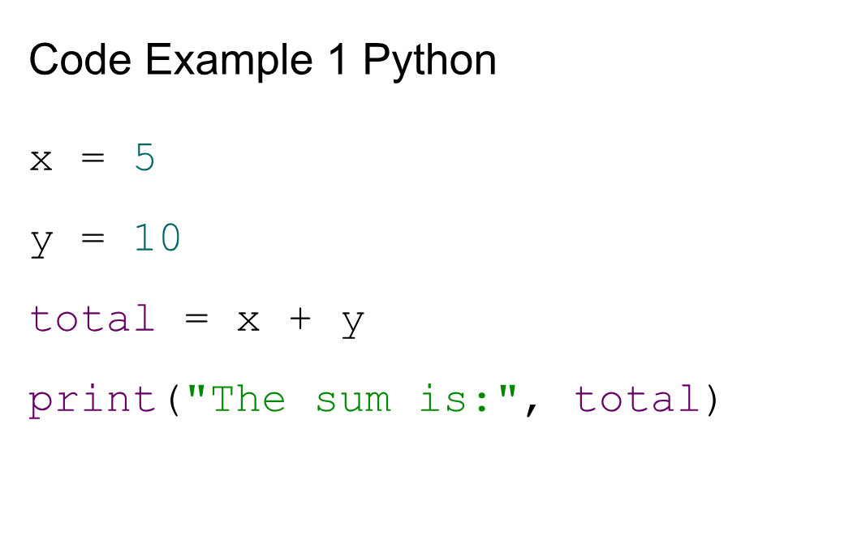

Slide 7
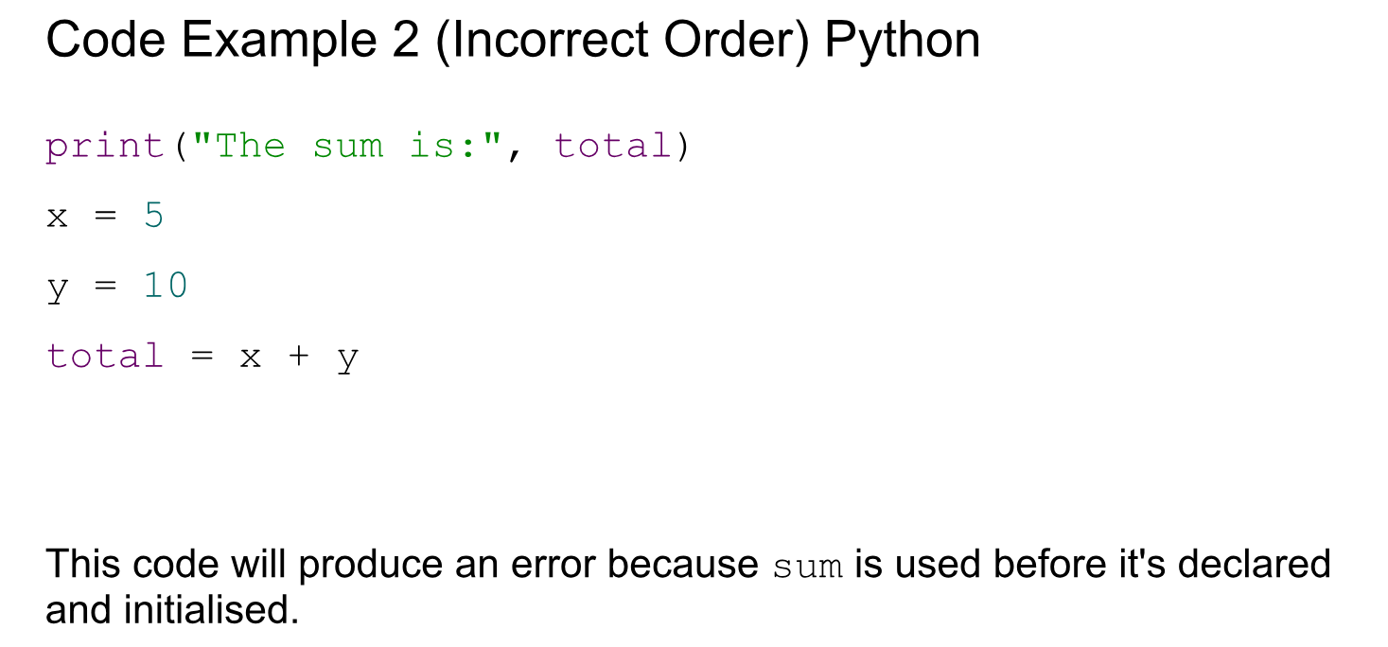

Slide 8


Slide 9
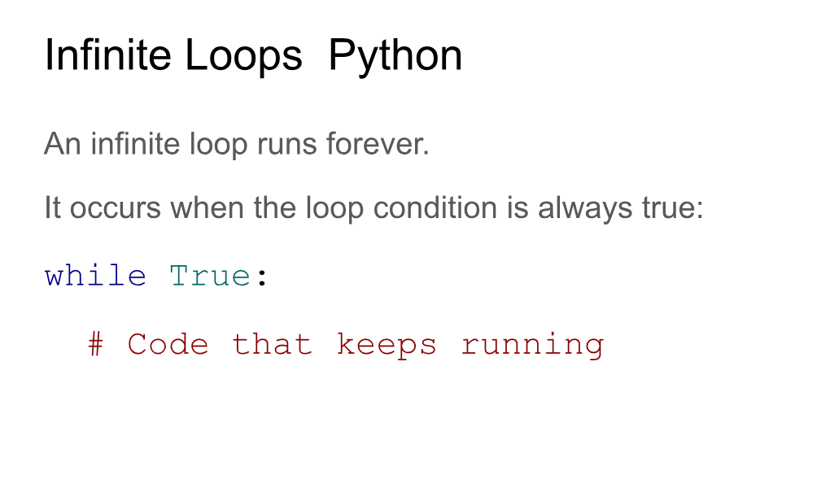

Slide 10
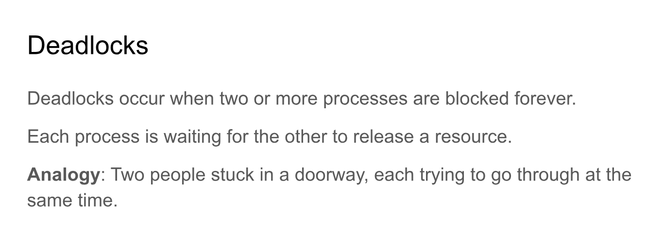

Slide 11
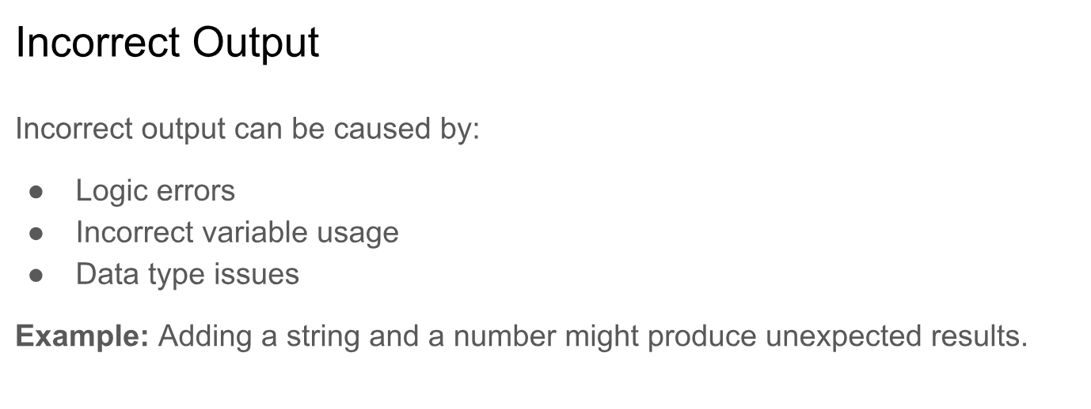

Slide 13
https://docs.google.com/document/d/1LOLDZ9K7lEe71hLsZPERxwPNj4k1aBJYaV8-jS64RuQ/edit?usp=sharing

